Slide 1

CREDIT CARD FRAUD DETECTION
Manaswi Kamila

Slide 2
AGENDA
Credit Card Fraud
Objective
Background
Key Insights
Cost benefit Analysis
Current losses incurred
Cost saving after model deployment
Appendix:
Data Set
Solution Methodology
Attached files
Notes:
Objective

Slide 3
CREDIT CARD FRAUD
Credit card fraud is any dishonest act or behavior to obtain information without the proper authorization of the account holder for financial gain.
Ways of making fraudulent transactions are as follows:
Manipulation or alteration of genuine cards
Creation of counterfeit cards
Stolen or lost credit cards
Fraudulent telemarketing
Skimming
The Federal Trade Commission (US) has estimated that around 10 million people become victims of credit card theft each year.
Credit card companies lose close to $50 billion per year to fraud.
Notes:
Objective

Slide 4
OBJECTIVE
Banking fraud is a concerning issue for both banks and customers alike in terms of substantial financial loss, trust and credibility.
As a consulting company, our task is to identify the root cause of unauthorized transactions on credit card/debit card and build a fraud detection model to help banks identify credit card frauds which would generate high revenue with minimal losses.
GOALS:
Detect fraudulent credit card transactions based on the historical transactional data of customers with a pool of merchants.
Minimize financial losses due to nefarious activities of credit card fraudsters which negatively impacts merchants, banks and individual customers.
Reduce time-consuming manual reviews, costly chargebacks and fees, and denial of legitimate transactions.
Notes:
Objective

Slide 5
BACKGROUND
Finex is a leading financial service provider based out of Florida, US. It offers a wide range of products and business services to customers through different channels, ranging from in-person banking and ATMs to online banking.
In recent times, Finex has observed that a significantly large number of unauthorized transactions are being made through credit/debit cards, due to which the bank has been facing a huge revenue and profitability crisis.
Retaining high profitable customer is the most important business goal. With rise in digital payment channels, banking fraud poses a significant threat to this goal for many banks.
In most cases, customers unaware of such ongoing credit card frauds. This has led to late complaint registration with Finex and by the time the case is flagged fraudulent, the bank incurs heavy losses and ends up paying the lost amount to the cardholders.
Notes:
Objective

Slide 6
KEY INSIGHTS
Maximum transactions are done between 12 PM to 11 PM. Fraudulent transactions are observed during 10 PM - 3 AM duration
Semi-urban areas have highest number of genuine transactions and fraudulent transactions.
Highest credit card transactions occur on Sunday and Monday. Fraudulent transactions are more on Sunday, Saturday and Monday.
Highest number of credit card transactions are observed for gas and transport, home and grocery categories and least for travel. Highest frauds are observed in grocery and shopping categories.
Highest number of transactions are observed in 30-50 age category. Fraudulent activities are higher when customer is beyond 60 years old.
Notes:
Objective

Slide 7
CURRENT INCURRED LOSSES
On an average, there are 77,183 number of credit card transactions per month
Of the 77,183 transactions, 402.12 transactions are fraudulent per month
Average amount per fraudulent transaction is $530.66.
Total costs incurred per month from fraudulent transactions is $213389
Notes:
Objective

Slide 8
COST SAVING AFTER MODEL DEPLOYMENT
3546 fraudulent transactions are detected by the machine learning model.
Cost of providing customer executive support per fraudulent transaction detected by the model is $1.5
20 fraudulent transactions are not detected by the model which incurs as loss of $10613.20
Total cost incurred after the model is deployed is $15932.32
Final savings after the model deployment is $197456.68
Hence, the reduction in loss is 92.53%
Notes:
Objective

Slide 9
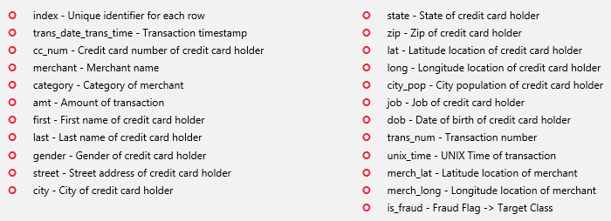
APPENDIX - DATA SET
The data set contains credit card transactions of around 1,000 cardholders with a pool of 800 merchants from 1 Jan 2019 to 31 Dec 2020.
It contains a total of 18,52,394 transactions, out of which 9,651 are fraudulent transactions.
The data set is highly imbalanced, with the positive class (frauds) accounting for 0.52% of the total transactions.
Attributes of the data sets
Notes:
Objective

Slide 10
APPENDIX - SOLUTION METHODOLOGY
Built machine learning models to predict fraudulent transactions using a simulated credit card transactional Kaggle data set as a proof of concept.
Steps involved
Understanding the data features and Exploratory data analytics.
Deriving new transactional and historical features from existing features.
Class imbalance is adjusted using SMOTE and ADASYN sampling methods.
Hyperparameter tuning done using RandomizedSearchCV.
Training different machine learning models on the train data set.
Evaluating the best model that has the best AUC ROC and recall metrics.
Performing a cost benefit analysis on the final model chosen.
Data story telling using the insights, modelling results and proposing business solution
Notes:
Objective

Slide 11
APPENDIX – ATTACHED FILES
Cost Benefit Analysis
Cost+Benefit+Analysis.xlsx
Credit card fraud detection model
Credit_Card_fraud_detection.ipynb
Notes:
Objective

Slide 12

Thank you

